Slide 1
Smart Irrigation
By
Team Name: Amigos
Team Members:
Mohammad Asra Fatima
Email: fatima07asra@gmail.com
Contact no: 95153 07883
2. Sabrina Shaik
Email: sabrina.shaik80@gmail.com
Contact no: 9642550879
3. Samreen Begum
Email: samreen15102000@gmail.com
Contact no: 6301 017 251

Slide 2
Smart Irrigation
Introduction:
Agriculture is the unquestionably the largest livelihood provider in India. With rising population, there is a need for increased agricultural production. In order to support greater production in farms, the requirement of the amount of fresh water used in irrigation also rises.
We tend to propose a solution of developing an automated irrigation system using IoT that could be controlled through mobile application.
Idea Explanation:
Our IoT based application will work to minimize the number of workers in a crop field, control and save water and electricity, Increase agricultural production using small quantities of water, minimize manual intervention in watering operations with increasing watering speed and preserving plants from fungi.

Slide 3
Block Diagram
YL69 Soil Moisture Sensor
LM35
Temperature Sensor
DHT11
Humidity Sensor
GSM GPRS SIM900A modem
Arduino Micro Controller
Relay
Motor
Mobile Device
Power Supply

Slide 4
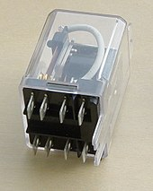
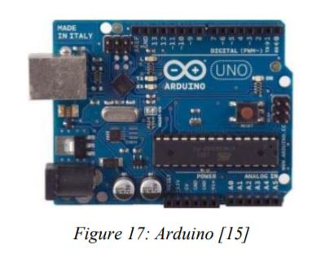
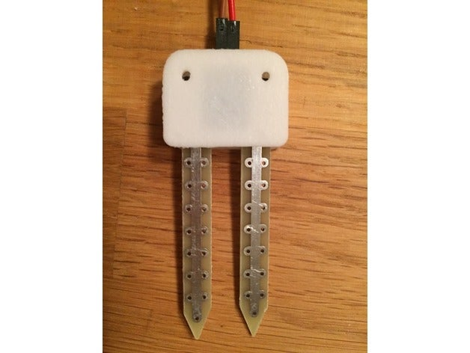
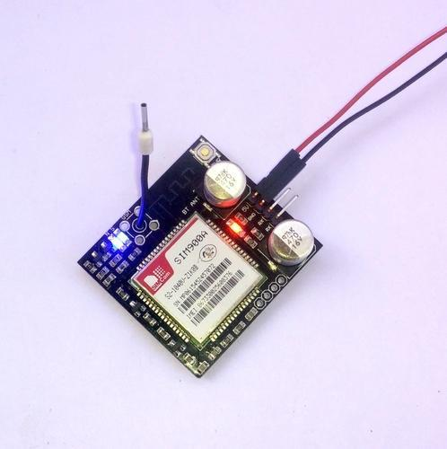
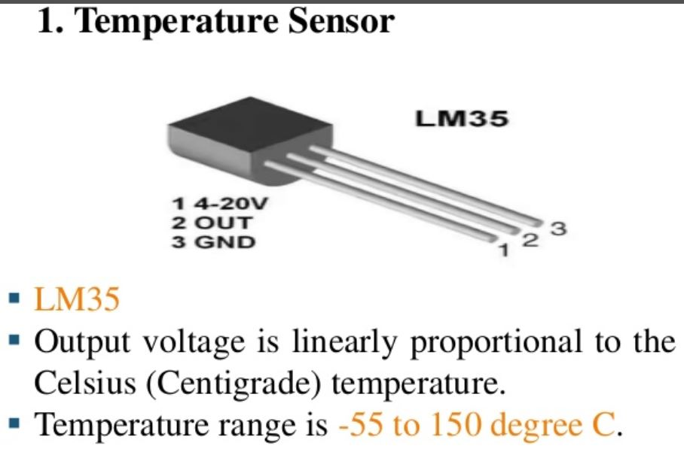
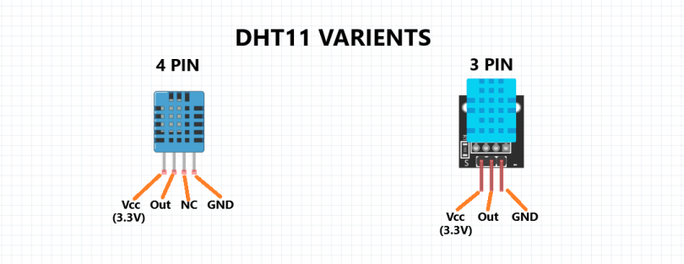
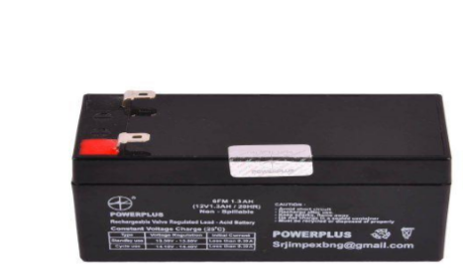
Hardware Components Required
Arduino Micro Controller
YL69 Soil Moisture Sensor
LM35 Temperature Sensor
DHT11 Humidity Sensor
Relay
GSM GPRS SIM900A modem
Rechargeable battery for Power Supply
Pump
1.
5.
2.
3.
6.
4.
7.

Slide 5
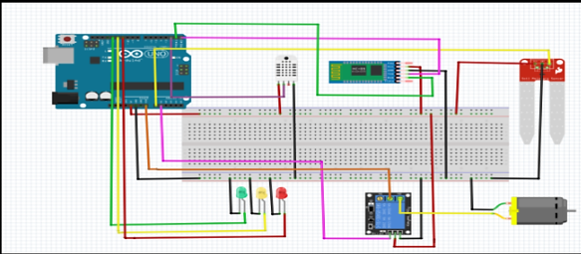
Material | Features
Arduino | Microcontroller AT mega328 Voltage of operating 5V Recommended input voltage 7-9V Range of input voltage 6-20V
Moisture sensor | Voltage of working 5v Current of working ˂ 20 mA Analog interface Detection depth 37mm Working temperature range 10 ͦC-30 Cͦ
Water pump | Voltage of Input: 6-12 VDC Rate of Flow: 1.5-2 L/min Temperature of Operation: 80 ͦ C Current of Operating: 0.5-0.7A Distance of Suction: 2 meter (Max) Pump Life: 2500 Hour
Rechargeable Battery | Type Lead acid Battery. Model PP 2.3-12 SV code 380301 AALV4 Brand Power Plus Color Black Battery Voltage 12V
Soil moisture
sensor
12V DC,1Amp POWER SOURCE
Channel Relay Module Board 5V LOW level trigger
12 V DC MOTOR WATER PUMP
Complete circuit diagram

Slide 6
Software Programming techniques
Thingspeak webserver: ThingSpeak is an open source Internet of Things (IoT) application and API to store and retrieve data from things using the HTTP protocol over the Internet or via a Local Area Network.
Readings from the two sensors were also transmitted to a THINGSPEAK channel to obtain graphs.
JSON Format: JavaScript Object Notation or JSON is an open-standard file format that uses human-readable text to transmit data objects consisting of attribute– value pairs and array data types (or any other serializable value).

Slide 7

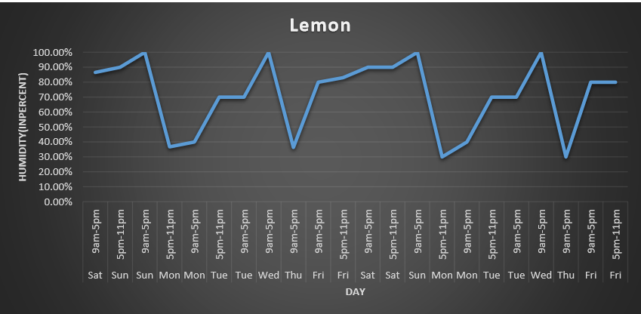



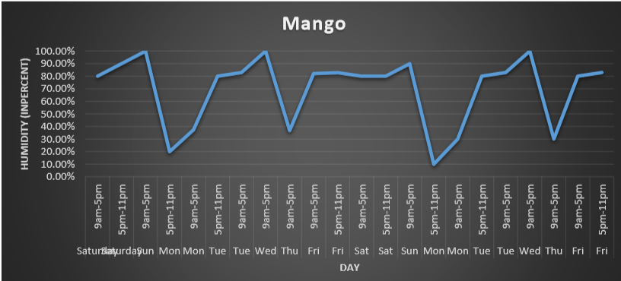
Application View
Smart Irrigation
Readings
Crop type 1
Temperature
21.23F
Humidity
61.39%
Soil Moisture
12%
Crop type 2
Click here for Graph
Motor Status
OFF
ON
Back
Home page
Sensor readings
Humidity Graph

Slide 8
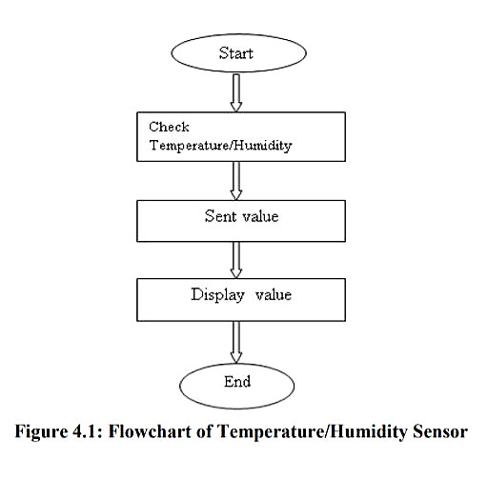
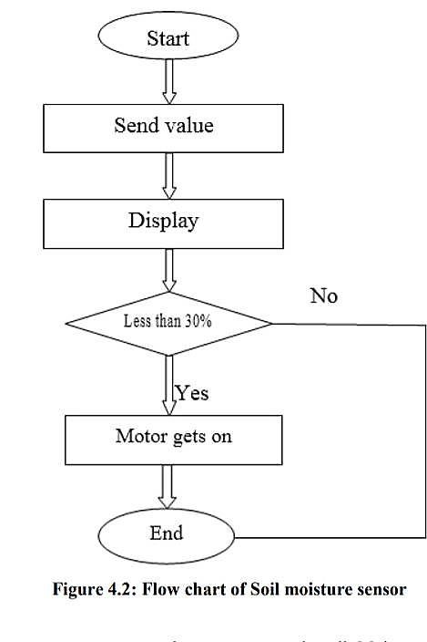
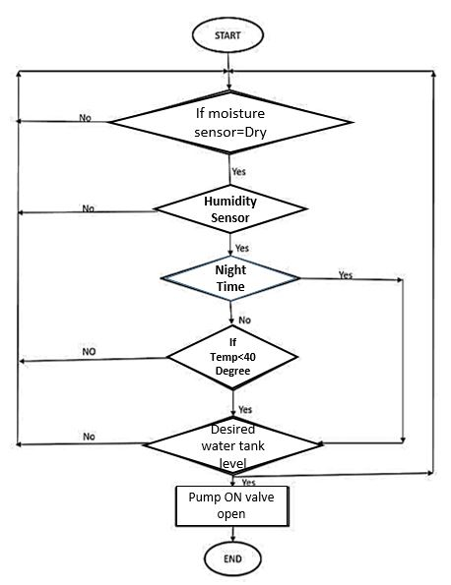
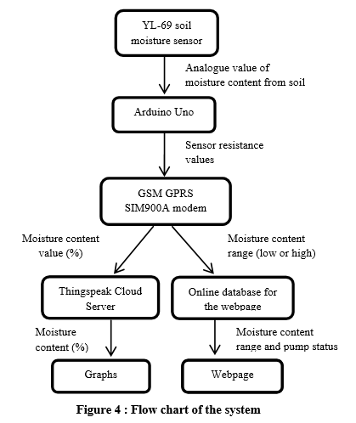
Flow chart of Temperature/Humidity Sensor
System working
Soil moisture sensor
Process implementation

